Slide 1
Applied Data Science Capstone Project
10/12/2020

Slide 2
Introduction
Analyze dataset of major hurricanes in Texas using Jupyter Notebooks
Dataset created from National Weather Service article
The information could be used by
Oil/Gas Industry
State/Local Governments
Construction (Home Building)
Insurance Companies
Utilities/Infrastructure

Slide 3
Data
 | Year | Month | Landfall | X | Y | Winds | Category | Casualties
0 | 1940 | August | Sabine Pass | -93.8948 | 29.7333 | 100 | 2 | 0
1 | 1941 | September | Sabine Pass | -93.8948 | 29.7333 | 120 | 3 | 4
2 | 1942 | September | Texas City | -94.9027 | 29.3838 | 80 | 1 | 0
3 | 1942 | August | Galveston | -94.7977 | 29.3013 | 115 | 3 | 8
4 | 1943 | July | Matagorda | -95.9683 | 28.6911 | 100 | 2 | 19
Dataset created from National Weather Service article
Includes 31 hurricanes that made landfall in Texas from 1940-2020
Includes Year, Month, Landfall location, coordinates, wind speed, category and casualties

Slide 4
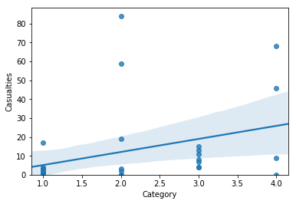
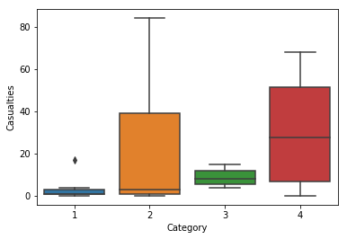
Methodology
Explore and analyze data to find any trends or correlation
Use regression, box plot and bar graph to analyze data
Map location of where the hurricanes made landfall

Slide 5
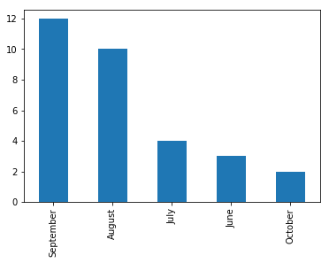
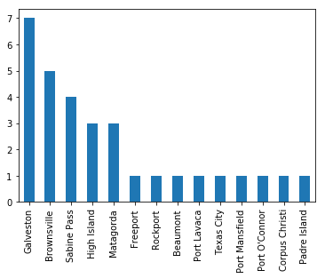
Methodology
Bar plot of most active months
Bar chart of most frequent landfall location

Slide 6
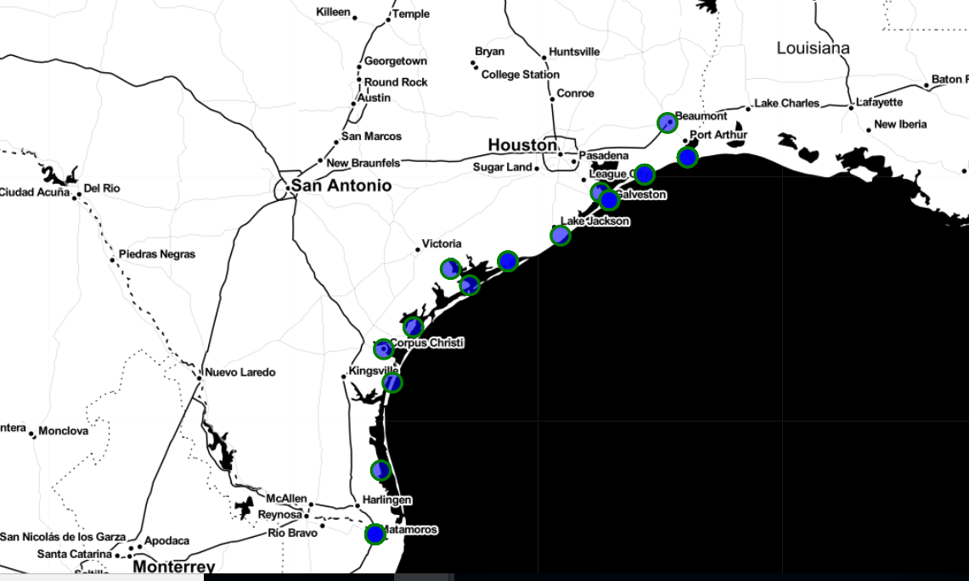
Map of landfall locations

Slide 7
Results & Discussion
Results
Discussion
Results show positive correlation between category and casualties
Most hurricanes made landfall around Houston, with Galveston having 7 major hurricanes
September is the most active month for hurricanes
Recommendations
Increased and upgraded flood infrastructure in and around Houston
Increased planning from state/local government for evacuation and preparedness
Find more data and variables to better understand the negative outcomes of hurricanes

